Slide 1
SPIN and Shapes RDF Data Shapes WG F2F, Nov 2014
Holger Knublauch
TopQuadrant, Inc.

Slide 2
SPIN History and Status
Created at TopQuadrant 2008
Addresses requirements from customer projects
Supported by TopBraid tools (incl. TBC Free)
Open source: http://topbraid.org/spin/api/
Partial support by 3rd party database vendors
W3C Member Submission 2011
Many SPIN-based systems are in production

Slide 3
Constraints in SPARQL (ASK)
ss:Square
spin:constraint [
a sp:Ask ;
sp:text """
# Width and height must be equal
ASK WHERE {
?this ss:width ?width .
?this ss:height ?height .
FILTER (?width != ?height) .
}
"""
]

Slide 4
Constraints in SPARQL (CONSTRUCT)
ss:Square
spin:constraint [
rdf:type sp:Construct ;
sp:text """
# Width and height must be equal
CONSTRUCT {
_:cv a spin:ConstraintViolation ;
spin:violationRoot ?this ;
spin:violationPath ss:height ;
rdfs:label "Width and height must be equal"
}
WHERE {
?this ss:width ?width .
?this ss:height ?height .
FILTER (?width != ?height) .
}
"""
]

Slide 5
Possible Syntactic Sugar
Idea from Simister, Brickley: http://www.w3.org/2001/sw/wiki/images/0/00/SimpleApplication-SpecificConstraintsforRDFModels.pdf
ss:Square
spin:constraint [
a spin:Ask ;
spin:context ss:height ;
spin:message "Width and height must be equal" ;
spin:sparql """
ASK WHERE {
?this ss:width ?width .
?this ss:height ?height .
FILTER (?width != ?height) .
}
"""
]
(The current SPIN is just a starting point, it’s an open RDF vocabulary)

Slide 6
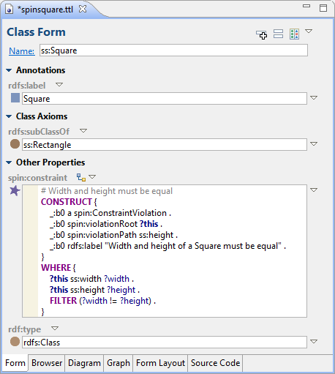
Alternative to source code editing
Syntax checking
Auto-complete
Keyword highlighting
Results preview …

Slide 7
Positive values constraint in SPARQL
ss:Rectangle
spin:constraint [
a sp:Construct ;
sp:text """
# The value of ss:width must be > 0
CONSTRUCT {
_:cv a spin:ConstraintViolation ;
spin:violationRoot ?this ;
spin:violationPath ss:width ;
rdfs:label "The width of a rectangle must be > 0"
}
WHERE {
?this ss:width ?width .
FILTER (?width <= 0) .
}
"""
]
… the same would have to be repeated for ss:height

Slide 8
Generalizing the constraint
ss:Rectangle
spin:constraint [
a sp:Construct ;
sp:text """
# The value of ss:width must be > 0
CONSTRUCT {
_:cv a spin:ConstraintViolation ;
spin:violationRoot ?this ;
spin:violationPath ss:width ;
rdfs:label "The width of a rectangle must be > 0"
}
WHERE {
?this ss:width ?width .
FILTER (?width <= 0) .
}
"""
]
ss:width could be replaced with any property, e.g. ss:height

Slide 9
Introducing a SPIN Template
ss:PositivePropertyValueConstraint a spin:ConstructTemplate ;
spin:constraint [ a spl:Argument
spl:predicate arg:property ;
spl:valueType rdf:Property ;
rdfs:comment "The property to constrain (e.g. ss:width)"
] ;
spin:body [ a sp:Construct ;
sp:text """
CONSTRUCT {
_:cv a spin:ConstraintViolation ;
spin:violationRoot ?this ;
spin:violationPath ?property ;
rdfs:label "Positive value expected"
}
WHERE {
?this ?property ?value .
FILTER (?value <= 0) .
}
"""
] ;

Slide 10
Using a SPIN Template
ss:Rectangle
spin:constraint [
a ss:PositivePropertyValueConstraint ;
arg:property ss:height ;
] ;
spin:constraint [
a ss:PositivePropertyValueConstraint ;
arg:property ss:width ;
] .
Such templates can be published in libraries, for example for Shapes.

Slide 11
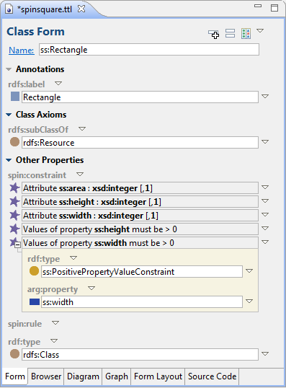
Example Tool Support (1)

Slide 12
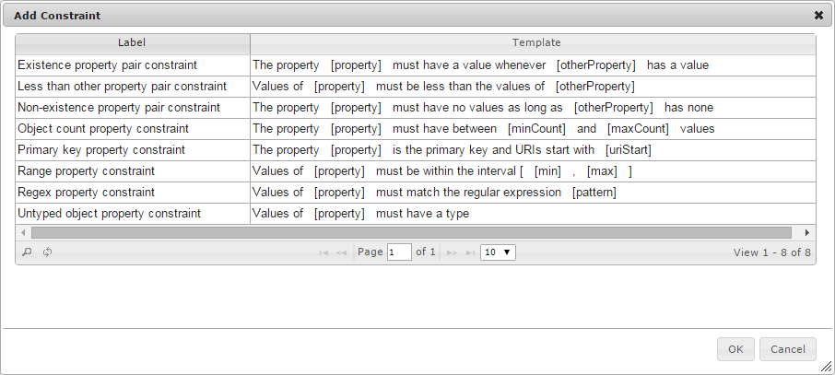
Example Tool Support (2)

Slide 13
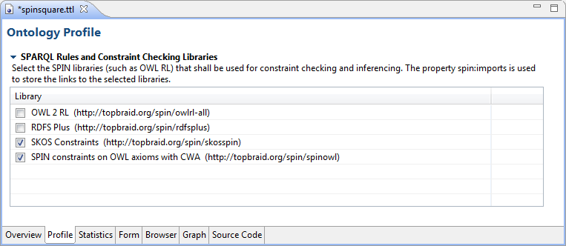
Example Tool Support (3)

Slide 14
SPIN Templates
Can define new modeling languages
Template definitions are linked data (URI etc)
Encapsulate/hide SPARQL queries
Yet executable on standard RDF databases
But processors do not have to use SPARQL only
Combine maximum flexibility & expressivity with a structural user-friendly syntax.

Slide 15
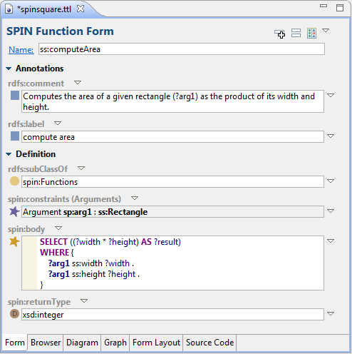
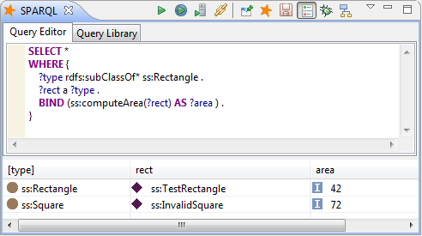
SPIN Functions

Slide 16
SPIN Libraries
SPIN templates, functions and constraints can be published on the semantic web
Example: http://semwebquality.org
Libraries define “Profiles”
Web provides a natural evolution mechanism
This WG would define a standard library

Slide 17
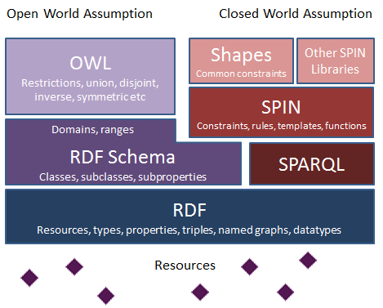
Possible Shapes Architecture

Slide 18
OSLC Bug Example
ChangeRequest
title : string [1..1]
status : status-values [0..1]
oslc_cm:ChangeRequest
a rdfs:Class ;
rdfs:label "Change request" ;
oslc:property [
a oslc:Property ;
oslc:propertyDefinition dcterms:title ;
oslc:occurs oslc:Exactly-one
] ;
oslc:property [
a oslc:Property ;
oslc:propertyDefinition oslc_cm:status ;
oslc:allowedValues oslc_cm:status-values ;
oslc:occurs oslc:Zero-or-one
] .
This is a valid SPIN document

